Slide 1
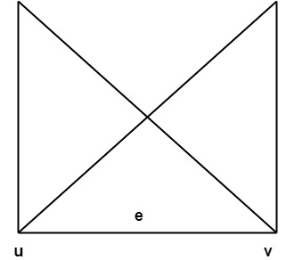
Graphs
Graph:
Graph G consists of two things:
1. A set V=V(G) whose elements are called vertices, points or nodes of G.
2. A set E = E(G) of an unordered pair of distinct vertices called edges of G.
3. We denote such a graph by G(V, E) vertices u and v are said to be adjacent if there is an edge e ={u, v}.

Slide 2
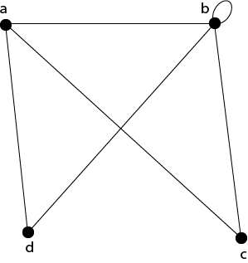
Graphs – Basic Concepts
Degree of a Vertex:
The degree of a vertex is the number of edges incident on a vertex v. The self-loop is counted twice. The degree of a vertex is denoted by d(v).
Example1: Consider the graph G shown in fig. Determine the degree of each vertex.
Solution:
The degree of each vertex is as follows:
d(a)=3;
d(b)=5;
d(c) = 2;
d(d)=2.

Slide 3
Graphs – Basic Concepts
Path:
A path of length n is a sequence of n+1 vertices of a graph in which each pair of vertices is an edge of the graph.
A Simple Path: The path is called simple one if no edge is repeated in the path, i.e., all the vertices are distinct except that first vertex equal to the last vertex.
An Elementary Path: The path is called elementary one if no vertex is repeated in the path, i.e., all the vertices are distinct.
Circuit or Closed Path: The circuit or closed path is a path in which starts and ends at the same vertex, i.e., v₀=v_{n}.
Simple Circuit Path: The simple circuit is a simple path which is a circuit.

Slide 4
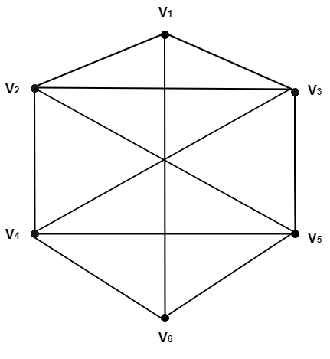
Graphs – Basic Concepts
A simple path fromV₁ to V₆. V_{1,}V_{2,}V_{3,}V_{4,}V_{5,}V₆.
An elementary path from V₁ to V₆. V_{1,}V_{2,}V_{3,}V_{5,}V_{4,}V₆.
A simple path which is not elementary from V₁ to V₆. V_{1,}V_{2,}V_{3,}V_{5,}V_{2,}V_{4,}V₆.
A path which is not simple and starting fromV₂. V_{2,}V_{3,}V_{4,}V_{5,}V_{3,}V_{4,}V₆.
A simple circuit starting fromV₁. V_{1,}V_{2,}V_{4,}V_{6,}V_{5,}V_{3,}V₁
A circuit which is not simple and starting from V₂. V_{2,}V_{3,}V_{1,}V_{2,}V_{5,}V_{4,}V₂.

Slide 5
Graphs – Basic Concepts
Pendant Vertex: A vertex with degree one is called a Pendant Vertex.
Pendant Edge: The only edge which is an incident with a pendant vertex is called the Pendant Edge.
Odd Vertex: A vertex having degree odd is called an odd vertex.
Even Vertex: A vertex having a degree even is called an even vertex.
Incident Edge: An edge is called incident with the vertices is connects.
Adjacent Vertices: Two vertices are called adjacent if an edge links them. If there is an edge (u, v), then we can say vertex u is adjacent to vertex v, and vertex v is adjacent to vertex u.

Slide 6
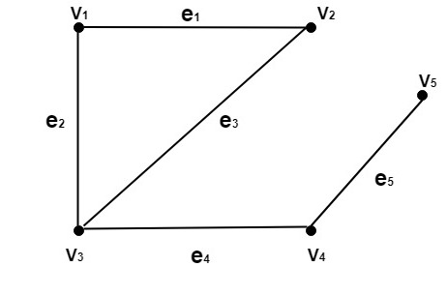
Graphs – Basic Concepts
Consider the graph as shown in fig:
Determine the following:
Pendant Vertices
Pendant Edges
Odd vertices
Even Vertices
Incident Edges
Adjacent Vertices

Slide 7
Graphs – Basic Concepts
Solution:
The vertex V₅is the pendant vertex.
The edge (V_{4,}V₅) or e₅ is the pendant edge.
The vertices V₃ and V₅ are odd vertices.
The vertices V_{1,} V_{2,}and V₄ are even vertices.
The edge e₁ is an incident on V_{1,} and V₂. The edge e₂ is an incident on V₁ and V₃. The edge e₃ is an incident on V₂ and V₃. The edge e₄ is an incident on V₃ and V₄. The edge e₅ is an incident on V₄ and V₅.
The vertex V₁ is adjacent to V₂ and V₃. The vertex V₂ is adjacent to V₁ and V₂. The vertex V₃ is adjacent to V₁ and V₄ The vertex V₄ is adjacent to V₃ and V₅ The vertex V₅ is adjacent to V₄.

Slide 8
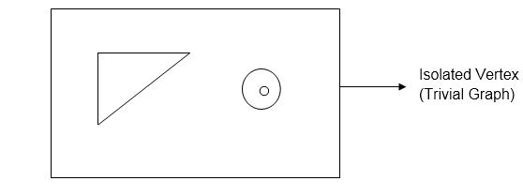
Graphs – Basic Concepts
Self-Loop: A self-loop is an edge e if it has the same endpoint.
The graph shown in fig contains the self-loop at vertex b,i.e., e=(b, b).
Isolated Vertex: A vertex with degree 0 is called Isolated Vertex.
Cut Set: Consider a graph G=(V, E).A cut set for G is the smallest set of edges such that the removal of the set, disconnected the graph whereas the removal of any proper subset of this set left a connected subgraph.
Cut Points or Cut Vertices: Consider a graph G=(V, E). A cut point for a graph G is a vertex v such that G-v has more connected components than G or disconnected.
The subgraph G-v is obtained by deleting the vertex v from graph G and also deleting the entire edges incident on v.

Slide 9
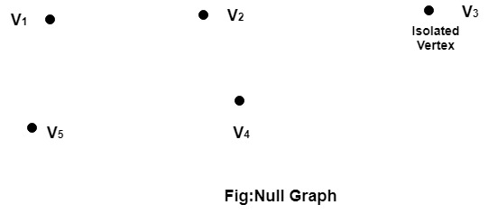
Graphs – Types of Graphs
1. Null Graph: A null graph is defined as a graph which consists only the isolated vertices.
Example: The graph shown in fig is a null graph, and the vertices are isolated vertices.

Slide 10
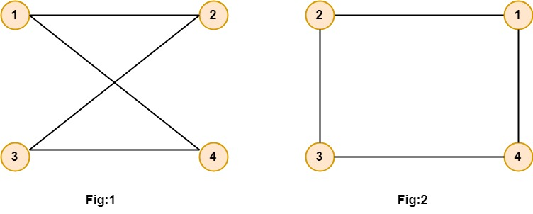
Graphs – Types of Graphs
2. Undirected Graphs: An Undirected graph G consists of a set of vertices, V and a set of edge E. The edge set contains the unordered pair of vertices. If (u, v)∈E then we say u and v are connected by an edge where u and v are vertices in the set V.
Example: Let V = {1, 2, 3, 4} and E = {(1, 2), (1, 4), (3, 4), (2, 3)}.Draw the graph.
Solution: The graph can be drawn in several ways.
Two of which are as follows:

Slide 11
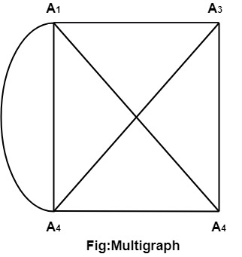
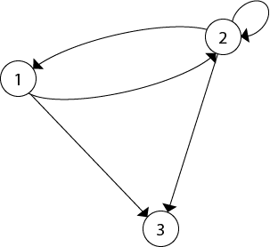
Graphs – Types of Graphs
3. Multigraph: If in a graph multiple edges between the same set of vertices are allowed, it is known as Multigraph. In other words, it is a graph having at least one loop or multiple edges.
4. Directed Graphs: A directed graph or digraph G is defined as an unordered pair (V, E), where V is the set of points called vertices and E is the set of edges. Each edge in the graph G is assigned a direction and is identified with an ordered pair (u, v), where u is the initial vertex, and v is the end vertex.

Slide 12
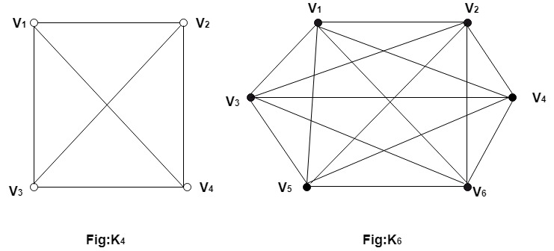
Graphs – Types of Graphs
5. Undirected Complete Graph: An undirected complete graph G=(V,E) of n vertices is a graph in which each vertex is connected to every other vertex i.e., and edge exist between every pair of distinct vertices. It is denoted by K_{n}.A complete graph with n vertices will have edges.

Slide 13
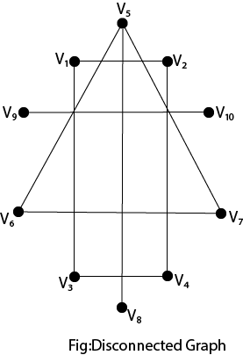
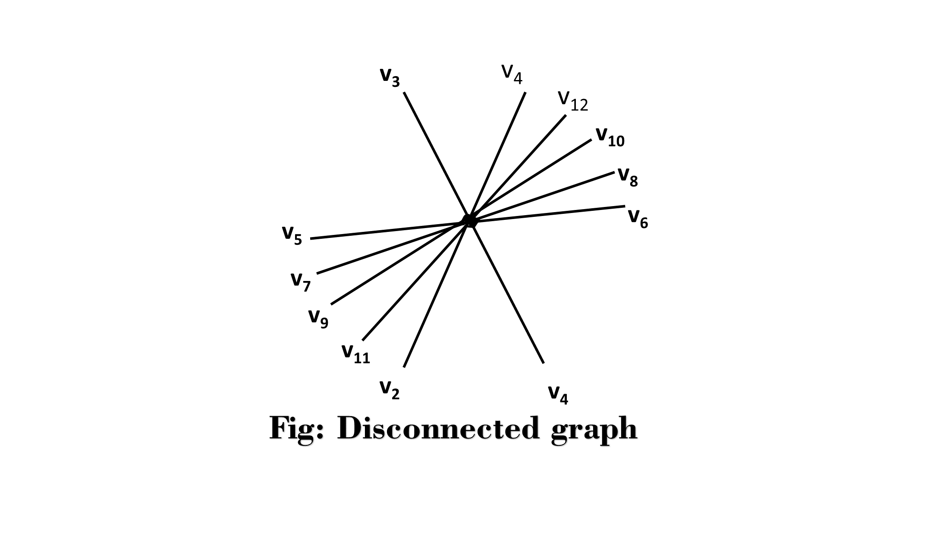
Graphs – Types of Graphs
6. Connected and Disconnected Graph:
Connected Graph: A graph is called connected if there is a path from any vertex u to v or vice-versa.
Disconnected Graph: A graph is called disconnected if there is no path between any two of its vertices.

Slide 14
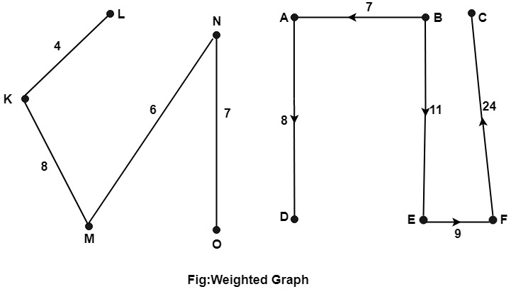
Graphs – Types of Graphs
Weighted Graphs: A graph G=(V, E) is called a weighted graph if each edge of graph G is assigned a positive number w called the weight of the edge e.
Example: The graph shown in fig is a Weighted Graph.

Slide 15

Graphs – Representation
Representation of Graphs:
There are two principal ways to represent a graph G with the matrix, i.e., adjacency matrix and incidence matrix representation.
(a)Representation of the Undirected Graph:
Adjacency Matrix Representation: If an Undirected Graph G consists of n vertices then the adjacency matrix of a graph is an n x n matrix A = [a_{ij}] and defined by
If there exists an edge between vertex v_{i} and v_{j}, where i is a row and j is a column then the value of a_{ij}=1.
If there is no edge between vertex v_{i} and v_{j}, then value of a_{ij}=0.

Slide 16
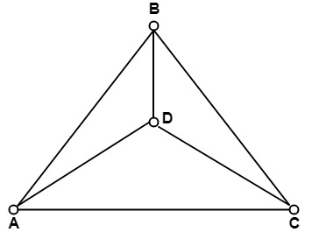
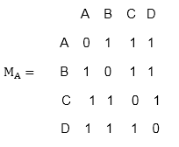
Graphs – Representation
Example: Find the adjacency matrix M_{A} of graph G shown in Fig:
Solution: Since graph G consist of four vertices. Therefore, the adjacency matrix wills a 4 x 4 matrix. The adjacency matrix is as follows in fig:

Slide 17

Graphs – Representation
Incidence Matrix Representation: If an Undirected Graph G consists of n vertices and m edges, then the incidence matrix is an n x m matrix C = [c_{ij}] and defined by
There is a row for every vertex and a column for every edge in the incident matrix.
The number of ones in an incidence matrix of the undirected graph (without loops) is equal to the sum of the degrees of all the vertices in a graph.

Slide 18
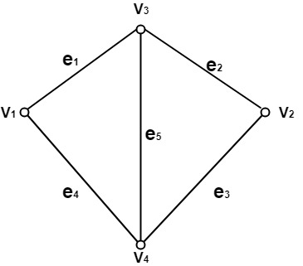
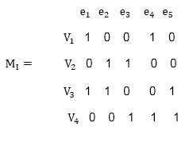
Graphs – Representation
Example: Consider the undirected graph G as shown in fig. Find its incidence matrix M_{I}.
Solution: The undirected graph consists of four vertices and five edges. Therefore, the incidence matrix is an 4 x 5 matrix, which is shown in Fig:

Slide 19

Graphs – Representation
Adjacency Matrix Representation: If a directed graph G consists of n vertices then the adjacency matrix of a graph is an n x n matrix A = [a_{ij}] and defined by
If there exists an edge between vertex V_{i} and V_{j}, with V_{i} as initial vertex and V_{j} as a final vertex, then the value of a_{ij}=1.
If there is no edge between vertex V_{i} and V_{j}, then the value of a_{ij}=0.
The number of ones in the adjacency matrix of a directed graph is equal to the number of edges.

Slide 20
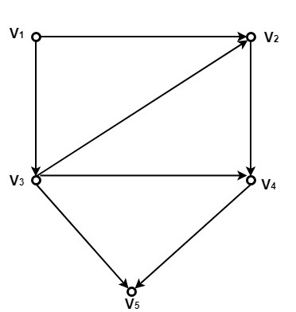
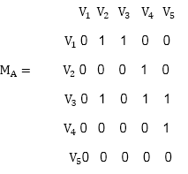
Graphs – Representation
Example: Consider the directed graph shown in fig. Determine its adjacency matrix M_{A}.
Solution: Since the directed graph G consists of five vertices. Therefore, the adjacency matrix will be a 5 x 5 matrix. The adjacency matrix of the directed graphs is as follows:

Slide 21
Isomorphic Graphs
Isomorphic Graphs:
Two graphs G₁ and G₂ are said to be isomorphic if −
Their number of components (vertices and edges) are same.
Their edge connectivity is retained.
Note − In short, out of the two isomorphic graphs, one is a tweaked version of the other. An unlabelled graph also can be thought of as an isomorphic graph.
There exists a function ‘f’ from vertices of G₁ to vertices of G₂
[f: V(G₁) ⇒ V(G₂)],
such that Case (i): f is a bijection (both one-one and onto)
Case (ii): f preserves adjacency of vertices,
i.e., if the edge {U, V} ∈ G₁, then the edge {f(U), f(V)} ∈ G₂, then G₁ ≡ G₂.

Slide 22
Isomorphic Graphs
Note
If G₁ ≡ G₂ then −
|V(G₁)| = |V(G₂)|
|E(G₁)| = |E(G₂)|
Degree sequences of G₁ and G₂ are same.
If the vertices {V₁, V₂, .. Vk} form a cycle of length K in G₁, then the vertices {f(V₁), f(V₂),… f(Vk)} should form a cycle of length K in G₂.
All the above conditions are necessary for the graphs G₁ and G₂ to be isomorphic, but not sufficient to prove that the graphs are isomorphic.
(G₁ ≡ G₂) if and only if (G₁− ≡ G₂−) where G₁ and G₂ are simple graphs.
(G₁ ≡ G₂) if the adjacency matrices of G₁ and G₂ are same.
(G₁ ≡ G₂) if and only if the corresponding subgraphs of G₁ and G₂ (obtained by deleting some vertices in G1 and their images in graph G₂) are isomorphic.

Slide 23
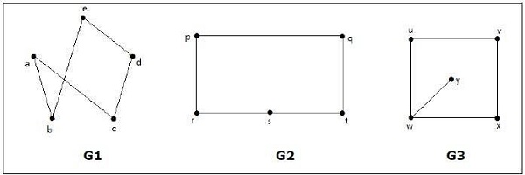
Isomorphic Graphs
Which of the following graphs are isomorphic?
In the graph G₃, vertex ‘w’ has only degree 3, whereas all the other graph vertices has degree 2. Hence G3 not isomorphic to G₁ or G₂.

Slide 24
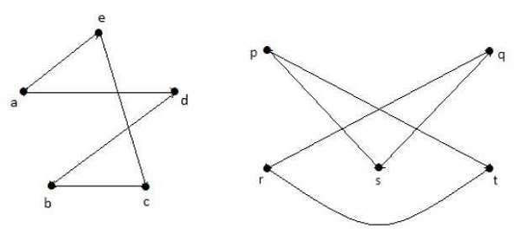
Isomorphic Graphs
Taking complements of G₁ and G₂, you have
Here, (G₁− ≡ G₂−), hence (G₁ ≡ G₂).

Slide 25
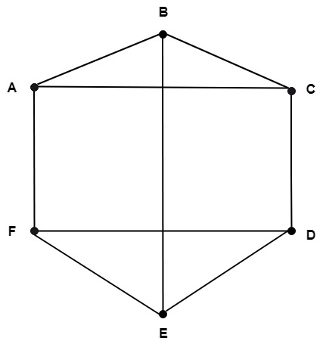
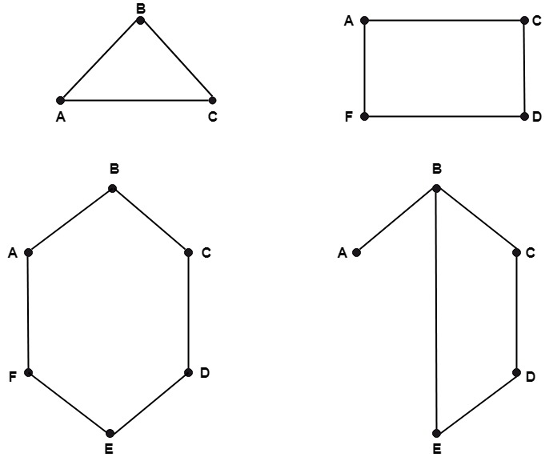
Subgraph
Subgraph:
A subgraph of a graph G=(V, E) is a graph G'=(V',E') in which V'⊆V and E'⊆E and each edge of G' have the same end vertices in G' as in graph G.
Note: A single vertex is a subgraph.
Example
GRAPH G
SUBGRAPHS ARE

Slide 26
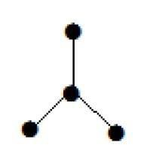

TREE
Tree
A connected acyclic graph is called a tree. In other words, a connected graph with no cycles is called a tree.
The edges of a tree are known as branches. Elements of trees are called their nodes. The nodes without child nodes are called leaf nodes.
A tree with ‘n’ vertices has ‘n-1’ edges. If it has one more edge extra than ‘n-1’, then the extra edge should obviously has to pair up with two vertices which leads to form a cycle. Then, it becomes a cyclic graph which is a violation for the tree graph.
Example

Slide 27
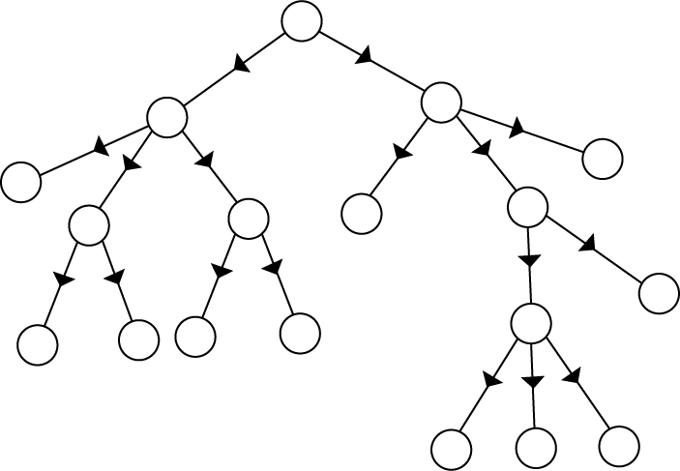
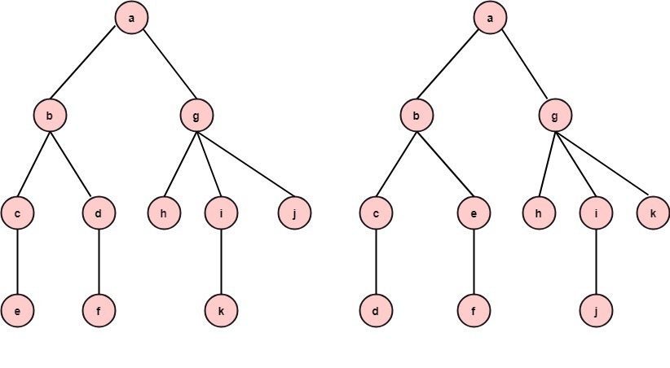
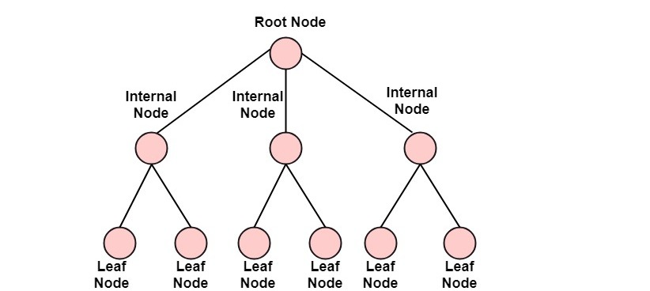
TREE
Directed Trees:
A directed tree is an acyclic directed graph. It has one node with indegree 1, while all other nodes have indegree 1 as shown in fig:
Ordered Trees:
If in a tree at each level, an ordering is defined, then such a tree is called an ordered tree.
Rooted Trees:
If a directed tree has exactly one node or vertex called root whose incoming degrees is 0 and all other vertices have incoming degree one, then the tree is called rooted tree.
Example

Slide 28
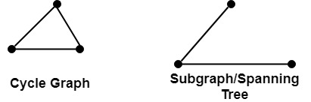
TREE
Properties of Trees:
There is only one path between each pair of vertices of a tree.
If a graph G there is one and only one path between each pair of vertices G is a tree.
A tree T with n vertices has n-1 edges.
A graph is a tree if and only if it a minimal connected.
Spanning Tree:
A subgraph T of a connected graph G is called spanning tree of G if T is a tree and T include all vertices of G.

Slide 29
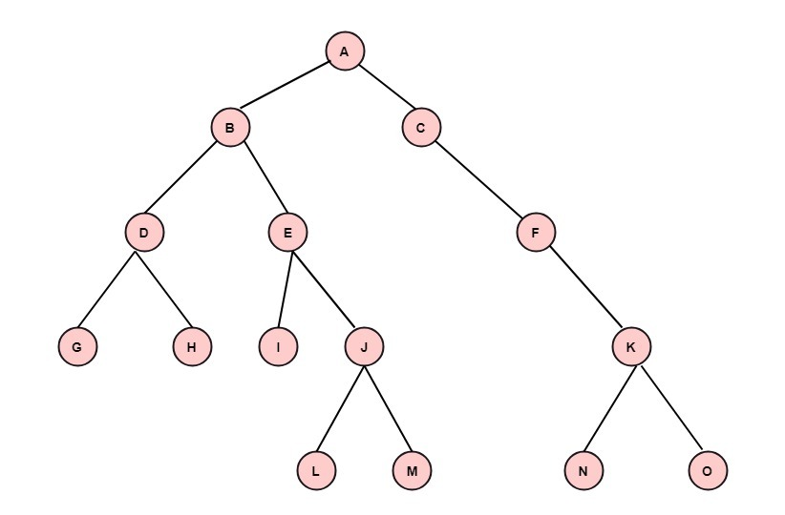
TREE
Minimum Spanning Tree:
Suppose G is a connected weight graph i.e., each edge of G is assigned a non-negative number called the weight of edge, then any spanning tree T of G is assigned a total weight obtained by adding the weight of the edge in T.
A minimum spanning tree of G is a tree whose total weight is as small as possible.
Binary Trees:
If the outdegree of every node is less than or equal to 2, in a directed tree than the tree is called a binary tree. A tree consisting of the nodes (empty tree) is also a binary tree. A binary tree is shown in fig:

Slide 30
TREE
Basic Terminology:
Root: A binary tree has a unique node called the root of the tree.
Left Child: The node to the left of the root is called its left child.
Right Child: The node to the right of the root is called its right child.
Parent: A node having a left child or right child or both are called the parent of the nodes.
Siblings: Two nodes having the same parent are called siblings.
Leaf: A node with no children is called a leaf. The number of leaves in a binary tree can vary from one (minimum) to half the number of vertices (maximum) in a tree.
Descendant: A node is called descendant of another node if it is the child of the node or child of some other descendant of that node. All the nodes in the tree are descendants of the root.
Left Subtree: The subtree whose root is the left child of some node is called the left subtree of that node.

Slide 31
TREE
Basic Terminology:
Right Subtree: The subtree whose root is the right child of some node is called the right subtree of that node.
Level of a Node: The level of a node is its distance from the root. The level of root is defined as zero. The level of all other nodes is one more than its parent node. The maximum number of nodes at any level N is 2N.
Depth or Height of a tree: The depth or height of a tree is defined as the maximum number of nodes in a branch of a tree. This is more than the maximum level of the tree, i.e., the depth of root is one. The maximum number of nodes in a binary tree of depth d is 2d-1, where d ≥1.
External Nodes: The nodes which have no children are called external nodes or terminal nodes.
Internal Nodes: The nodes which have one or more than one children are called internal nodes or non-terminal nodes.

Slide 32
TREE
Differentiate between General Tree and Binary Tree:
General Tree | Binary Tree
1. There is no such tree having zero nodes or an empty general tree. | 1. There may be an empty binary tree.
2. If some node has a child, then there is no such distinction. | 2. If some node has a child, then it is distinguished as a left child or a right child.
3. The trees shown in fig are the same, when we consider them as general trees. | 3. The trees shown in fig are distinct, when we consider them as binary trees, because in (4) is the right child of 2 while in (ii) 4 is a left child of 2.

Slide 33
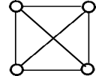
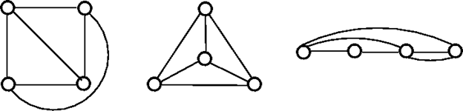
Planar Graph
A planar graph is a graph that we can draw in a plane in such a way that no two edges of it cross each other except at a vertex to which they are incident.
The above graph may not seem to be planar because it has edges crossing each other. But we can redraw the above graph.
The three plane drawings of the above graph are:

Slide 34
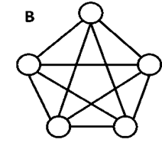
Non - Planar Graph
A graph that is not a planar graph is called a non-planar graph. In other words, a graph that cannot be drawn without at least on pair of its crossing edges is known as non-planar graph.

Slide 35
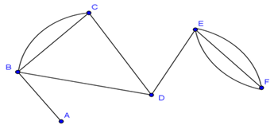
Multi Graph
A graph in which there are multiple edges between any pair of vertices or there are edges from a vertex to itself (loop) is called a multi - graph.
In the above graph, vertex-set B and C are connected with two edges. Similarly, vertex sets E and F are connected with 3 edges.
Therefore, it is a multi graph.

Slide 36

Euler's Theorem
State and Prove Euler's Theorem:
Statement: Consider any connected planar graph G= (V, E) having R regions, V vertices and E edges. Then V+R-E=2.
Proof: Use induction on the number of edges to prove this theorem.
Basis of Induction: Assume that each edge e=1.Then we have two cases, graphs of which are shown in fig:
In Fig: we have V=2 and R=1. Thus 2+1-1=2
In Fig: we have V=1 and R=2. Thus 1+2-1=2.
Hence, the basis of induction is verified.

Slide 37
Euler's Theorem - proof
Induction Step: Let us assume that the formula holds for connected planar graphs with K edges.
Let G be a graph with K+1 edge.
Firstly, we suppose that G contains no circuits. Now, take a vertex v and find a path starting at v. Since G is a circuit free, whenever we find an edge, we have a new vertex. At last, we will reach a vertex v with degree1. So we cannot move further as shown in fig:
Now remove vertex v and the corresponding edge incident on v. So, we are left with a graph G* having K edges

Slide 38
Euler’s Circuit
Euler’s Path:
An Euler’s path contains each edge of ‘G’ exactly once and each vertex of ‘G’ at least once. A connected graph G is said to be traversable if it contains an Euler’s path.
Euler’s circuit:
In a Euler’s path, if the starting vertex is same as its ending vertex,
then it is called an Euler’s circuit.
Euler Graph:
An Euler Graph is a graph that possesses a Euler Circuit.
A Euler Circuit uses every edge exactly once, but vertices may be
repeated.

Slide 39
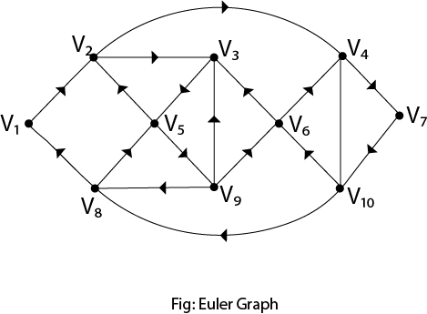
Euler’s Circuit

Slide 40
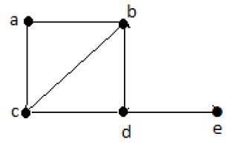
Hamiltonian Graph
Hamiltonian Graph:
A connected graph G is said to be a Hamiltonian graph, if there exists a cycle which contains all the vertices of G.
Every cycle is a circuit but a circuit may contain multiple cycles. Such a cycle is called a Hamiltonian cycle of G.
Hamiltonian Path
A connected graph is said to be Hamiltonian if it contains each vertex of G exactly once. Such a path is called a Hamiltonian path.
Hamiltonian Path− e-d-b-a-c.
Note
Euler’s circuit contains each edge of the graph exactly once.
In a Hamiltonian cycle, some edges of the graph can be skipped.

Slide 41
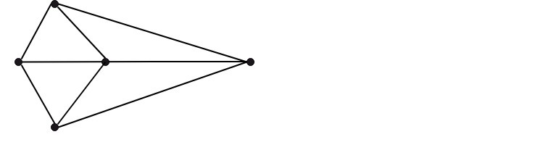
Chromatic Numbers
Graph Coloring:
Suppose that G= (V,E) is a graph with no multiple edges.
A vertex coloring of G is an assignment of colors to the vertices of G such that adjacent vertices have different colors.
A graph G is M-Colorable if there exists a coloring of G which uses M-Colors.
Proper Coloring: A coloring is proper if any two adjacent vertices u and v have different colors otherwise it is called improper coloring.
The graph shown in fig is a minimum 3-colorable, hence x(G)=3

Slide 42
Chromatic Numbers
Chromatic number of G: The minimum number of colors needed to produce a proper coloring of a graph G is called the chromatic number of G and is denoted by x(G).
Example: The chromatic number of K_{n} is n.
Solution: A coloring of K_{n} can be constructed using n colours by assigning different colors to each vertex. No two vertices can be assigned the same colors, since every two vertices of this graph are adjacent. Hence the chromatic number of K_{n}=n.
Applications of Graph Coloring:
Register Allocation
Map Coloring
Bipartite Graph Checking
Mobile Radio Frequency Assignment
Making a time table, etc.

Slide 43

Chromatic Numbers
Four color Theorem:
If the regions of a planar graph are colored so that adjacent regions have different colors, then no more than 4 colors are required.

